Slide 1
Introduction to Transformers
Gholamreza Dar, Amirhassan Amirmahani

Slide 2
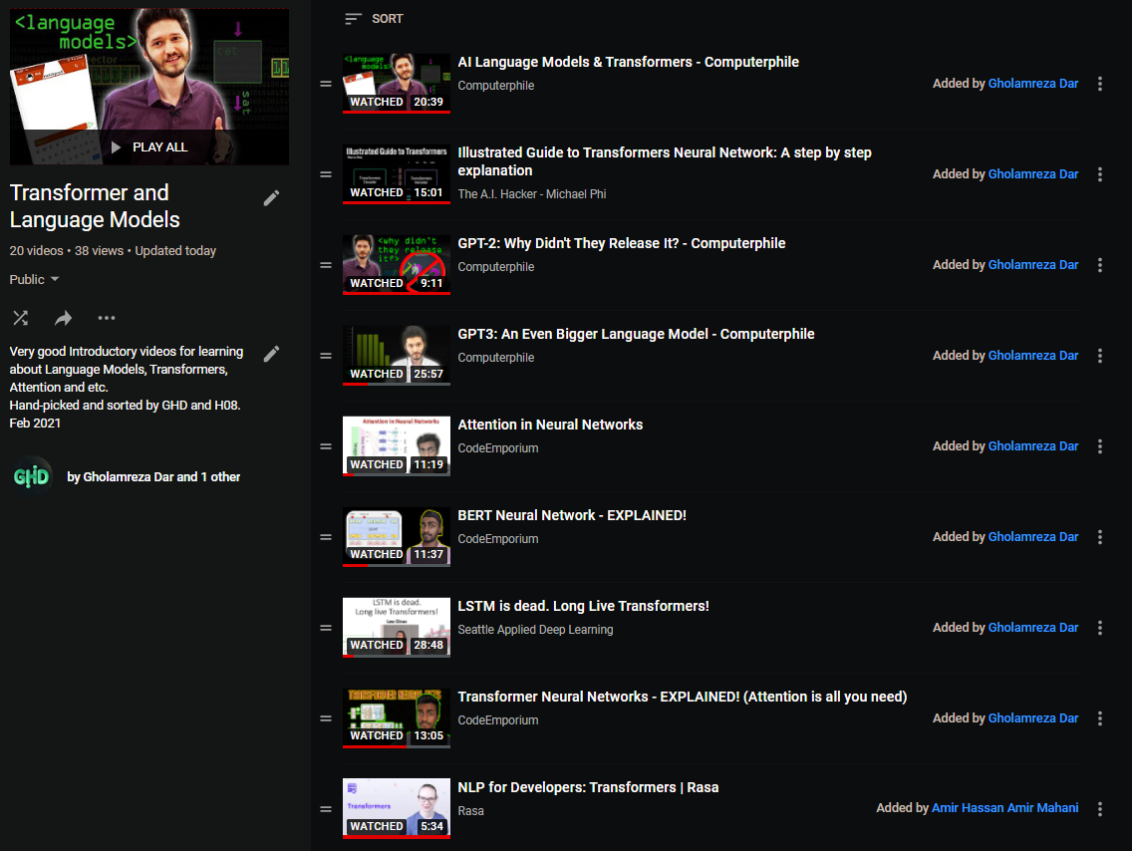
YouTube Playlist

Slide 3

Recurrent neural network (1986)
Language Translation
Text Summarization
Next Sentence Prediction

Slide 4
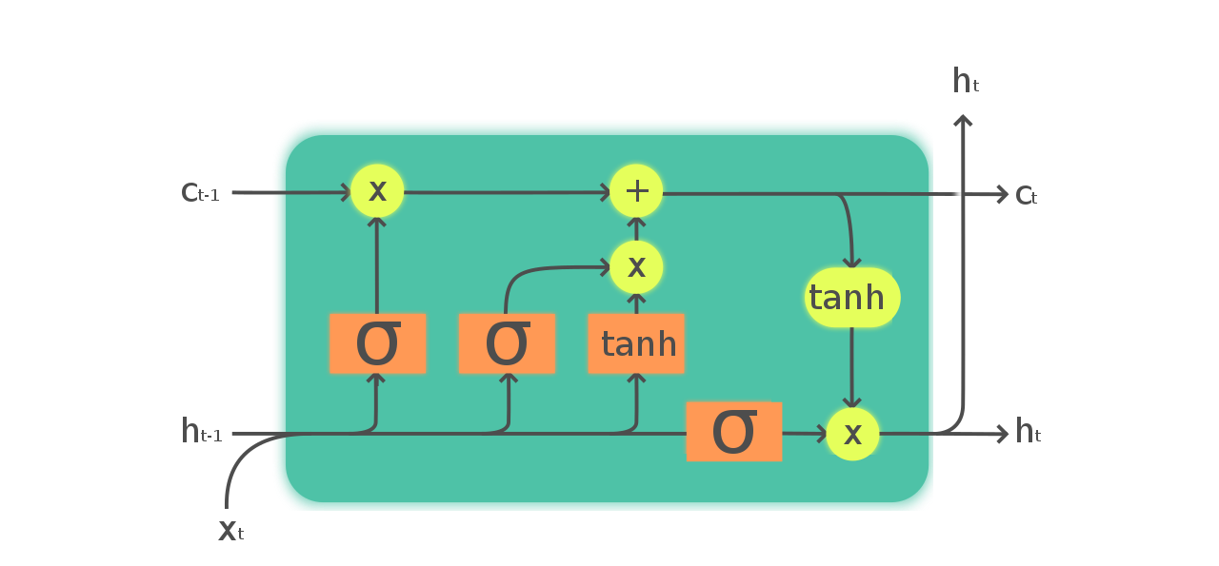
LSTM (1997)
RNNs using LSTM units partially solve the vanishing gradient problem

Slide 5
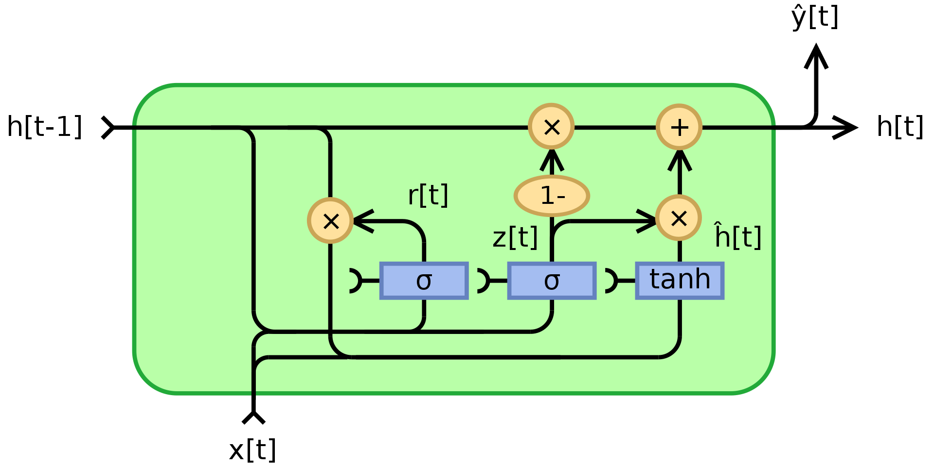
GRU (2014)
Better performance on smaller and less frequent datasets than LSTM.

Slide 6
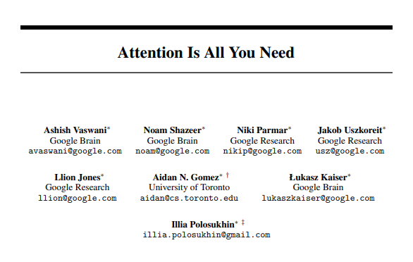
Attention is all you need (2017) Cited by 18060

Slide 7
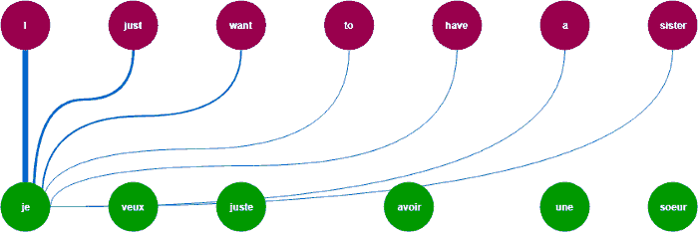
Attention in Neural networks

Slide 8
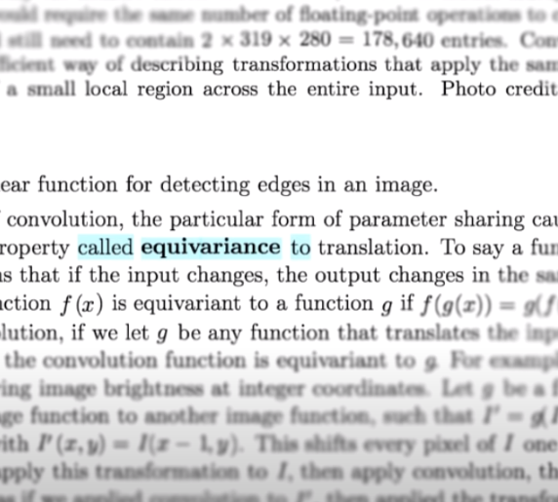
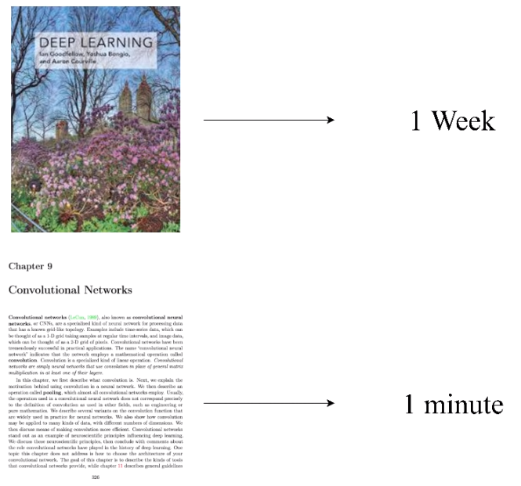
Example : Searching for “Equivariance” in a book
YT - CodeEmporium

Slide 9
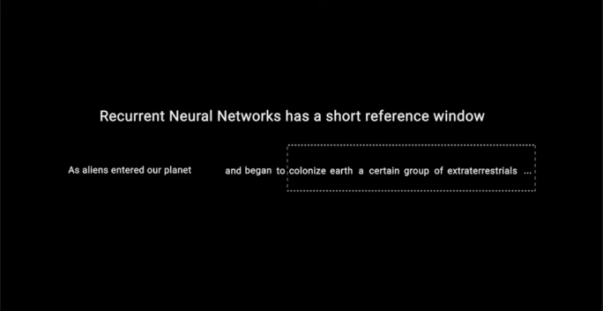
RNN vs LSTM vs Attention
YT-Michael Phi

Slide 10
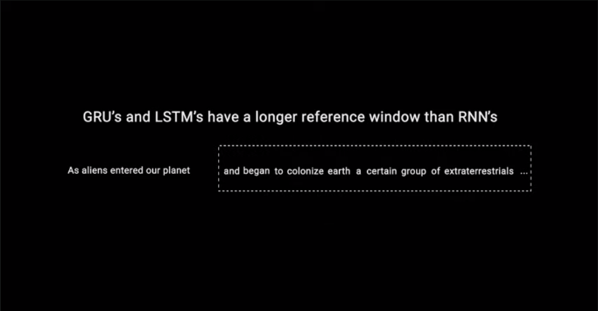
RNN vs LSTM vs Attention
YT-Michael Phi

Slide 11
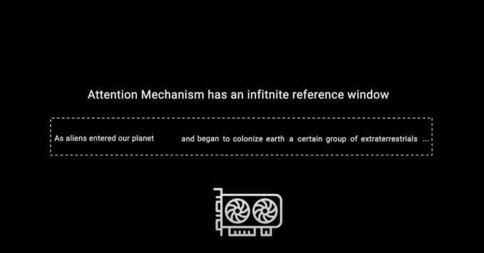
RNN vs LSTM vs Attention
YT-Michael Phi

Slide 12
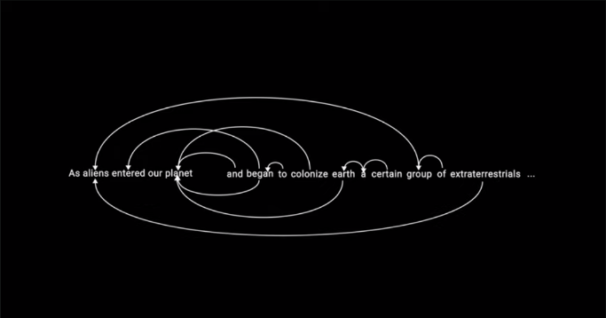
RNN vs LSTM vs Attention
YT-Michael Phi

Slide 13
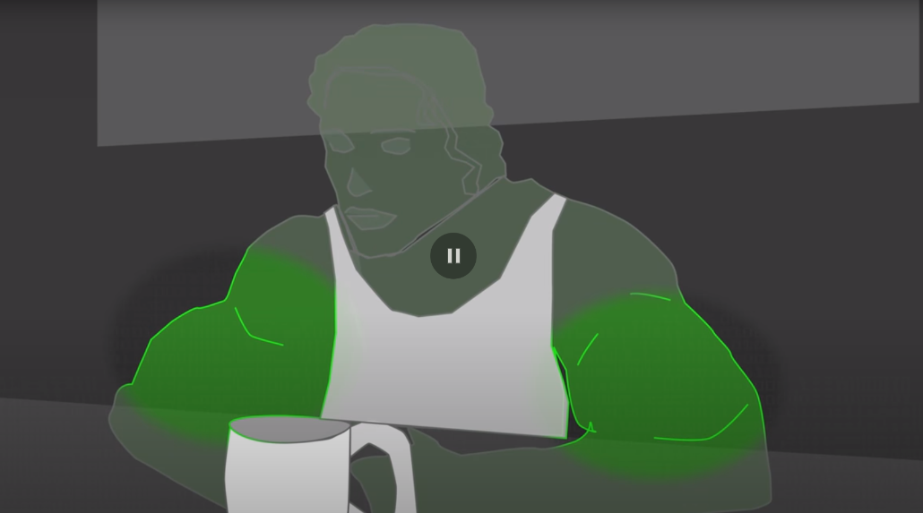
Attention example in images
A bodybuilder holding a dumbbell
YT - Computerphile

Slide 14
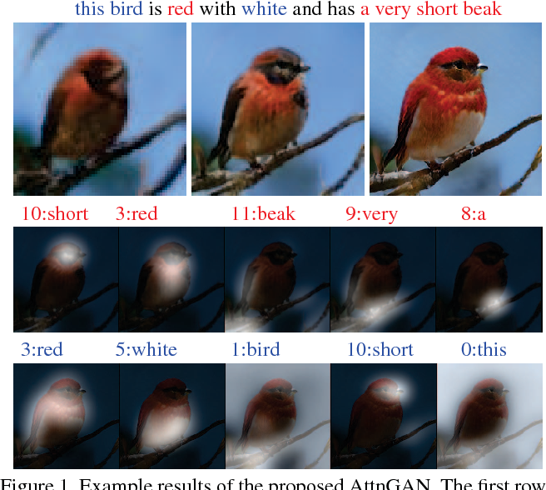
Microsoft Attention GANs

Slide 15
Self Attention
Self-attention, sometimes called intra-attention is an attention mechanism relating different positions of a single sequence in order to compute a representation of the sequence. Self-attention has been used successfully in a variety of tasks including reading comprehension, abstractive summarization, textual entailment and learning task-independent sentence representations

Slide 16

Transformers

Slide 17
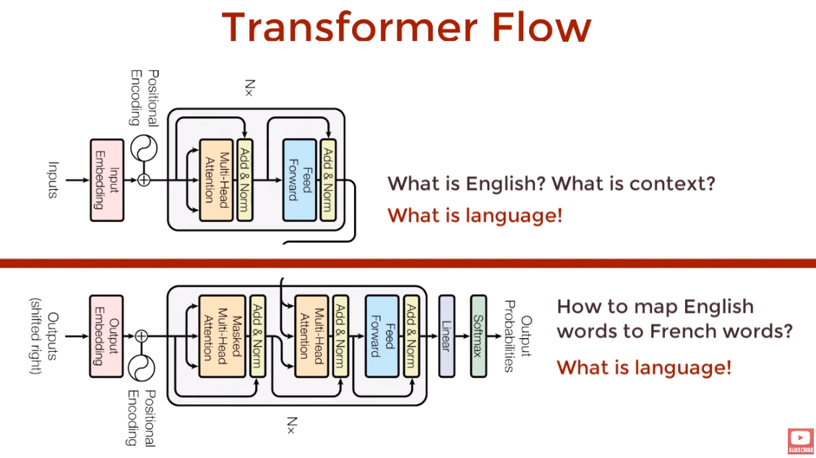
Encoder and Decoder
YT-CodeEmporium

Slide 18
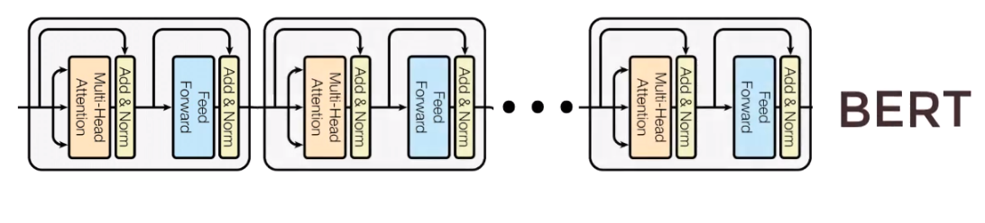
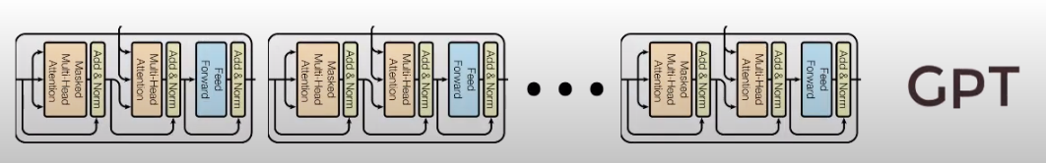
BERT and GPT
BERT (2018) by Google
A stack of Encoders
GPT (2018) by OpenAI
A stack of Decoders
YT-CodeEmporium

Slide 19
BERT(Bidirectional Encoder Representations from Transformers)
state-of-the-art performance on a number of NLU tasks
GLUE (General Language Understanding Evaluation)
SQuAD (Stanford Question Answering Dataset)
SWAG (Situations With Adversarial Generations)

Slide 20
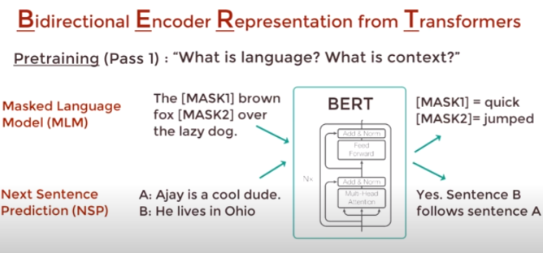
BERT pre-training procedure
Masked Language Model
Next Sentence Prediction
YT-CodeEmporium

Slide 21
GPT-1(Generative Pre-trained Transformer)
GPT is a "transformer" model, which uses "attention" in place of previous recurrence- and convolution-based architectures.
It showed how a generative model of language is able to acquire world knowledge and process long-range dependencies by pre-training on a diverse corpus with long stretches of contiguous text.

Slide 22
GPT-2 (1.5 Billion Parameters)
Dataset for pretraining : 40 GB of text
required tens of petaflop/s-days*
translates text, answers questions, summarizes passages, and generates text output on a level that, while sometimes indistinguishable from that of humans
*One petaflop/s-day is approximately equal to 10²⁰ neural net operations

Slide 23
GPT-3 (175 Billion Parameters)
Dataset for pretraining : 570 GB of text
required several thousand petaflop/s-days*
*One petaflop/s-day is approximately equal to 10²⁰ neural net operations

Slide 24
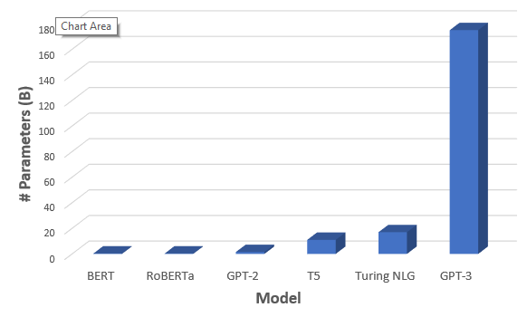
Comparison of sizes

Slide 25
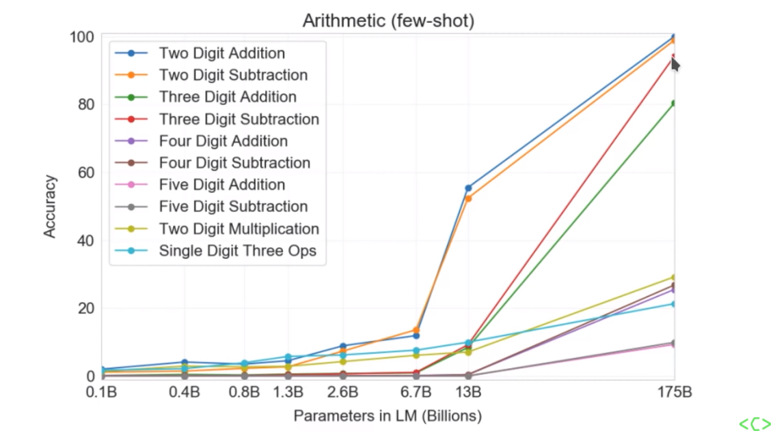
Size Matters!

Slide 26
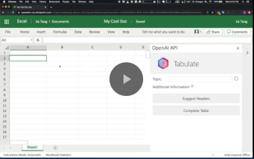
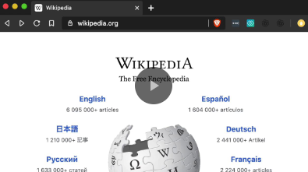
GPT-3 Demos

Slide 27
Transformers Drawbacks
Very large models.
Memory and compute intensive to train
Relatively young class of models
so we know less about them
Might be worse for hierarchical data (Tran et al, ACL 2018)
YT-Rasa

Slide 28
Challenges
Transformer complexity
Longer sequences

Slide 29
Shrinking Transformer
Transformers are becoming both more accurate and larger (t5 has 11 billion parameters )
But there are ways to make them smaller without hurt performance:
Quantization
Distillation
Pruning
More specialized models
Notes:
Recently released t5 has 11 billion parameters

Slide 30
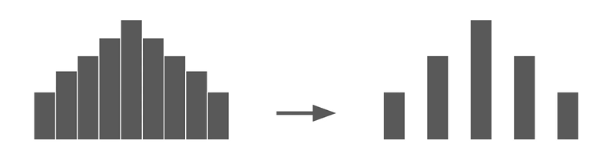
Quantization
Reduced number of bit needed to store the trained parameters in model
Convert 32 bit floating point to 8 bit integer
Problem: usually hardware dependant
YT-Rasa

Slide 31
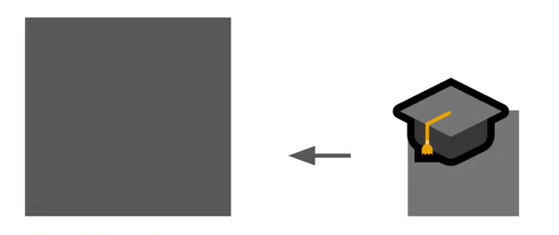
Distillation
A new model is trained to predict the weights of one or more layers of the larger model
Up to 100x smaller and 15x faster
Problem: need more setup
YT-Rasa

Slide 32
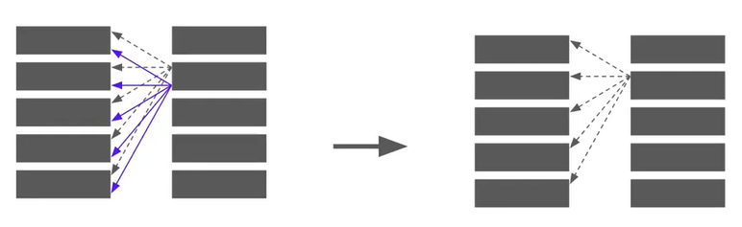
Pruning
Remove attention heads based on how useful they are for a specific task
Up to 80% the heads of trained transformer heads can removed without significantly reducing accuracy
YT-Rasa

Slide 33
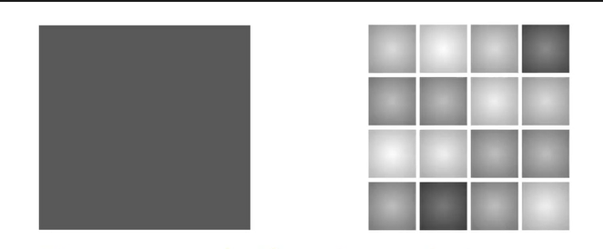
More specialized models
Train a special smaller model
Really large nlp models (like bert & gpt) tend to be open domain
YT-Rasa

Slide 34
Why don’t these methods hurt performance?
Really large transformers are bigger than they need to be for some tasks
There is a lot of redundancy in these models
YT-Rasa

Slide 35
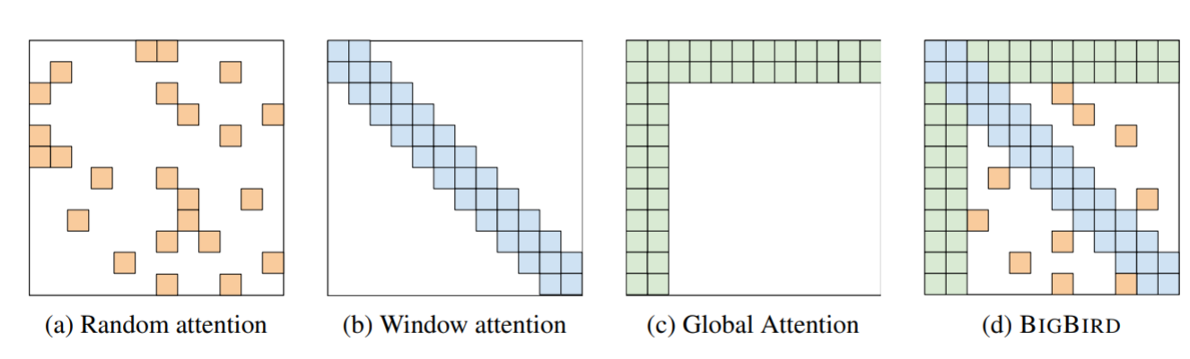
Bigbird
last revised 8 Jan 2021

Slide 36
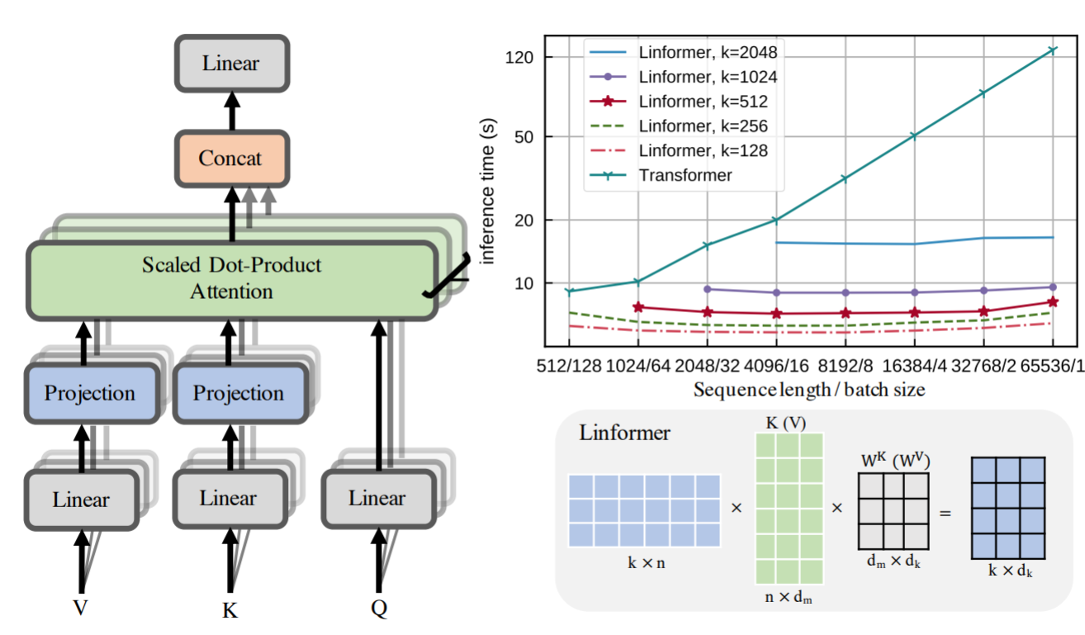
Linformer
last revised 14 Jun 2020

Slide 37
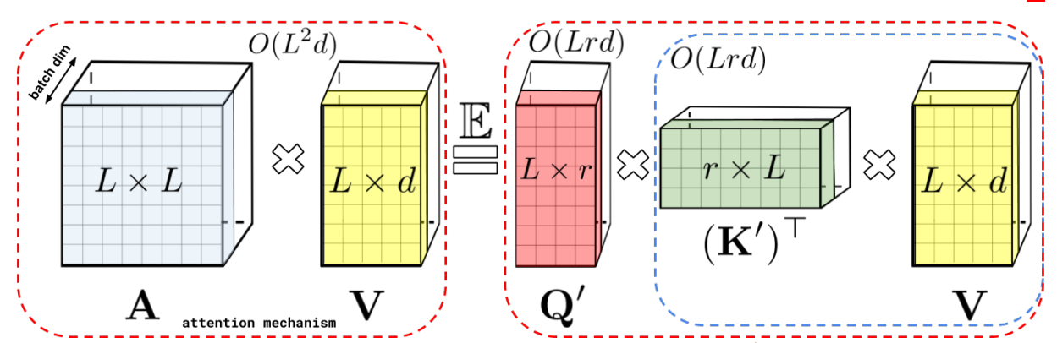
Performer
last revised 16 Feb 2021

Slide 38
References
Recurrent neural network - Wikipedia
Long short-term memory - Wikipedia
Gated recurrent unit - Wikipedia
Transformer and language models - YouTube (playlist)
BigBird - arxiv
Linformer - arxiv
Performer - arxiv

Slide 39
Thanks
hasanmahani08@gmail.com
rezadar1378@gmail.com

